Slide 1

Project Update

Slide 2
Project Overview
EDUkid is an Android Application to help children learn
It will support Letters, Numbers, Colors, and Shapes out of the box
Each category will allow for the parent to upload custom pictures and for letters, customer word associations
It will allow custom learning module creation

Slide 3
Project Overview
Custom play timer to allow parents to set sensible play times
Protected settings will prevent children from editing any of the settings the parents control

Slide 4
Possible Additional Features
NFC integration to support additional colors and games
A game mode to test the child’s success
A summary page for parents to view their child’s success, and any areas that may require additional attention

Slide 5
Objectives Overview
Produce a basic android application
The application will assist in teaching children the fundamentals of letters, numbers, colors, and shapes
Fixed Cost in terms of man hours
Fixed deadline

Slide 6
Management Overview
Iterative Model
Weekly Status Meetings
Risks
Completion of planned functionality
Comprehension of new tools and development kits that may not be familiar to the entire team
Ability for a large team of 8 to be productive and work together

Slide 7
Environment Overview
Using the Android Developer Toolkit provided by Google
Targeting Android OS 4.3 on both Tablet and Phone
Using GitHub as a code repository and branch management application
Using PivotalTracker for Story Tracking, and Change requests

Slide 8
QA Plan
We are still working on a QA plan and hope to have one determined by the end of the day today

Slide 9
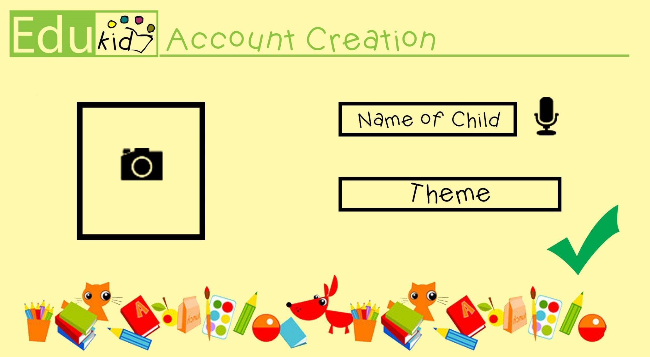
Design Overview
Account Creation Page

Slide 10

Design Overview
Main Menu

Slide 11
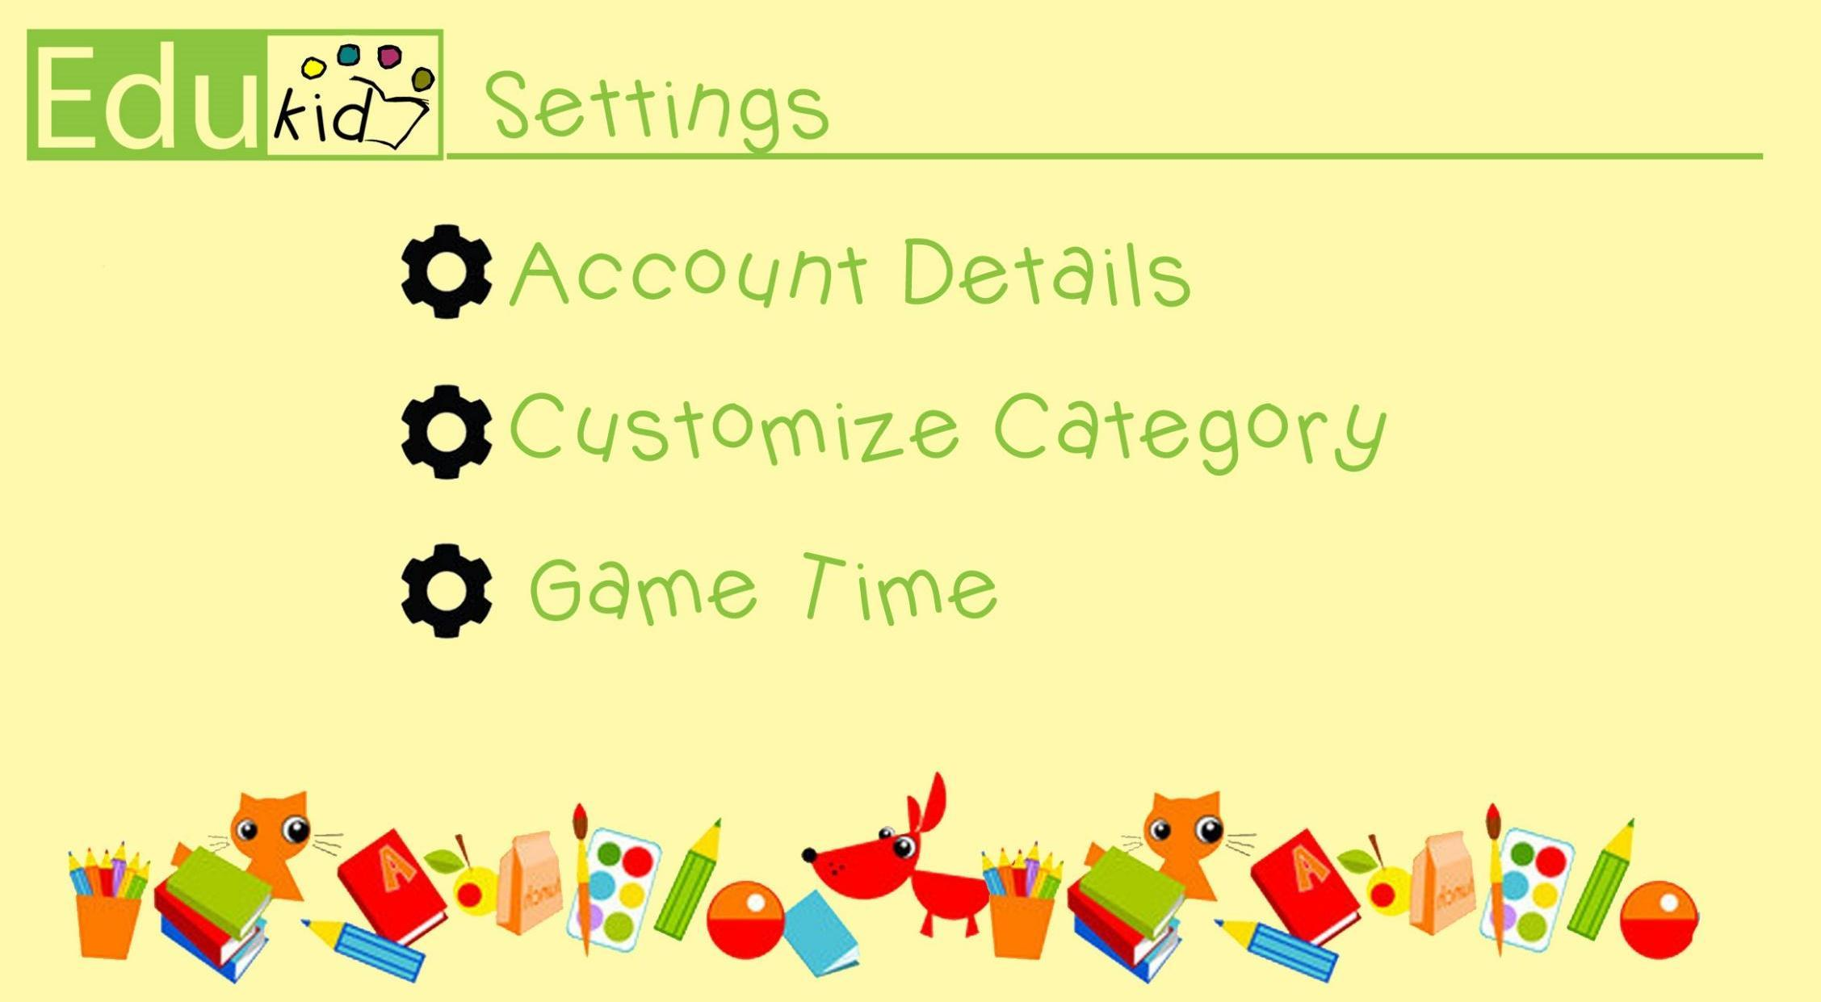
Design Overview
Settings Menu

